Slide 1
Continuous Distributions: Normal Distribution

Slide 2
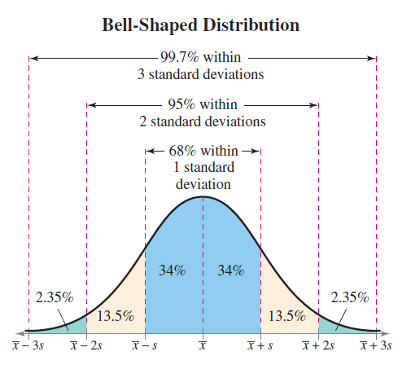
Real life and Normal Distribution
Many real-life data points follow Normal Distribution:
People’s heights and weights
Population blood pressure
Test scores
Also called as Gaussian Distribution
Generally, less/non-natural phenomena do not have normal distributions, e.g. income of people

Slide 3
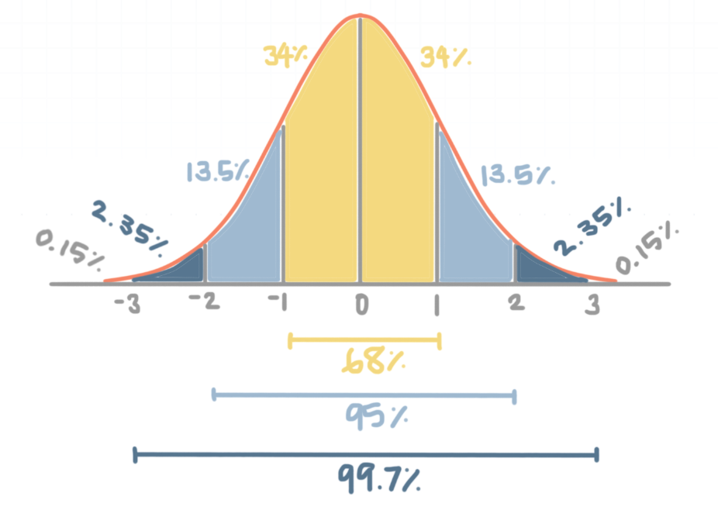
Normal Distribution: Key Features
Symmetry: Perfect symmetry around the mean
Mean = Median = Mode = Center point of the normal distribution
Bell-shaped curve
Empirical rule:
68% of the data falls within Mean ± 1 SD
95% of the data falls within Mean ± 2 SD
99.7% of the data falls within Mean ± 3 SD
Z-score (Standard score): Useful in finding relative position of an observation with respect to the overall population

Slide 4
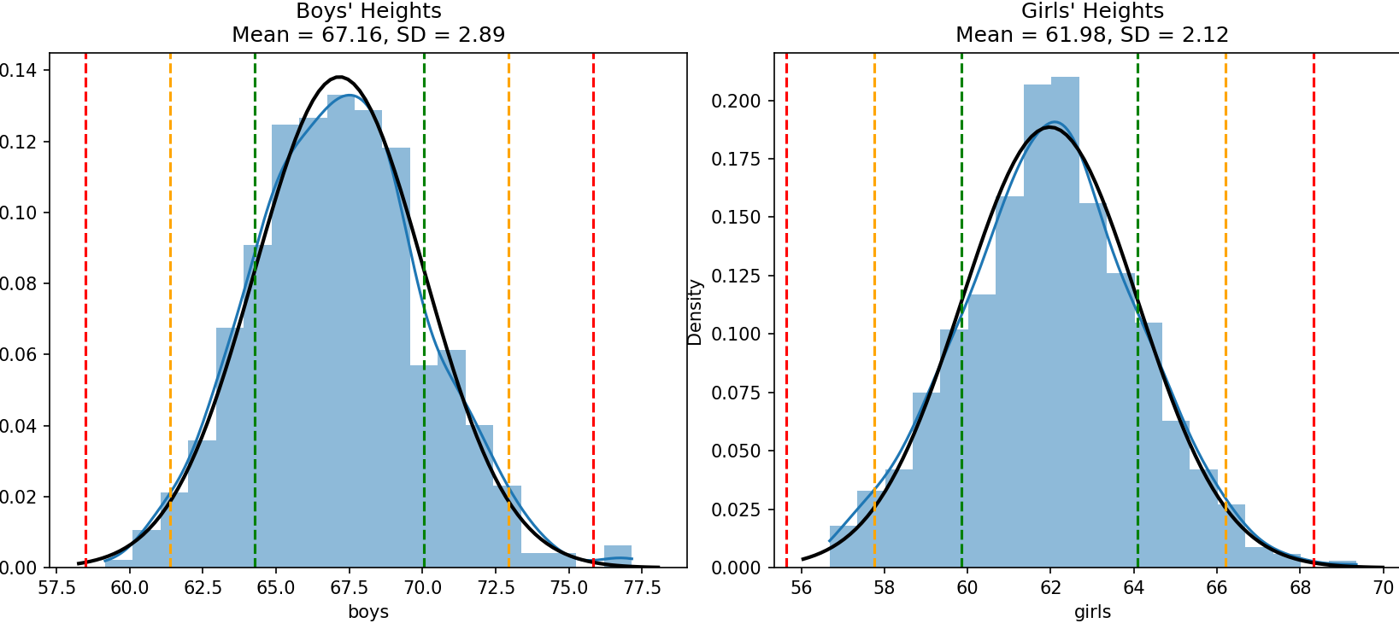
Example: Student Heights (C:\code\Data Analytics\normal_distribution.py)

Slide 5
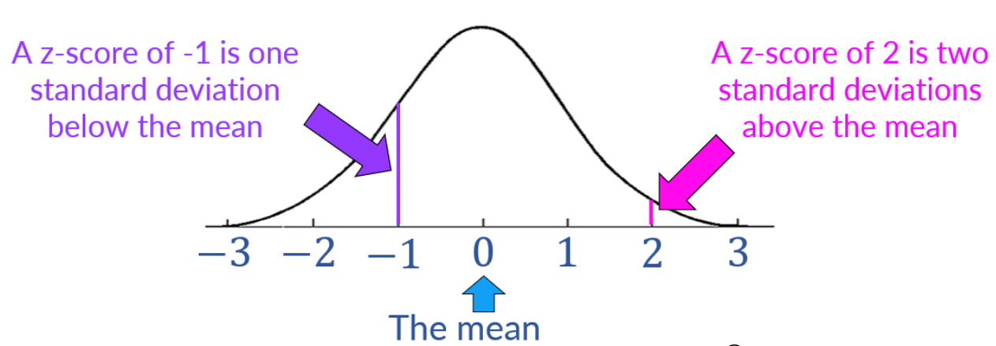

Z-Score Calculations
Z-Score (Standard Score): Describes how many standard deviations away a data point is from the mean
$\text{Z}\text{−}\text{Score}= \frac{x − μ}{σ}$
x: individual data value
μ: population mean
σ: population standard deviation
Z-scores > +3 and < -3 are considered outliers

Slide 6
Z-Score: Problem
A runner participated in a 200m race and a 500m race
Consider the following, calculate Z-scores and determine where she did better
Race | Average time | Standard deviation | Runner’s time
200m | 31s | 1.5s | 28s
500m | 125s | 8.2s | 132s

Slide 7


Z-Score Example
A runner participated in a 200m race and a 500m race
Consider the following and determine where she did better
Race | Average time | Standard deviation | Runner’s time
200m | 31s | 1.5s | 28s
500m | 125s | 8.2s | 132s
200m
$$Z= \frac{X − μ}{σ}=\frac{28 −31}{1.5}=−2$$
500m
$$Z= \frac{X − μ}{σ}=\frac{132 −125}{8.2.}=0.854$$

Slide 8
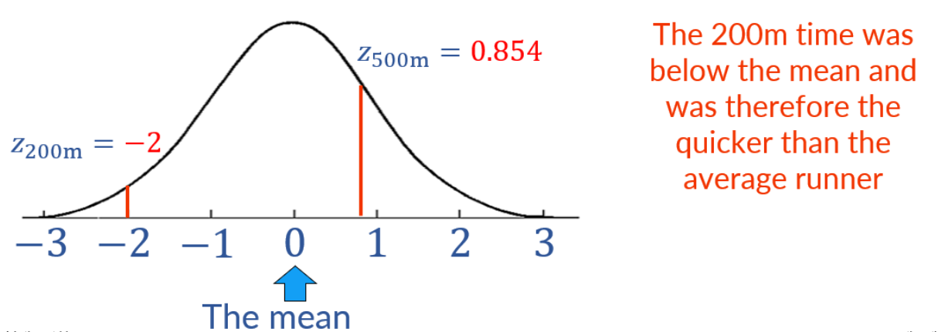
Visualizing Z-Scores
In other examples, positive/higher Z-score will be better, e.g. marks obtained by a student – Because, here the student would want to be above average
In this example, a lower time would be preferable when completing a race and so, the lower z-score would be better

Slide 9
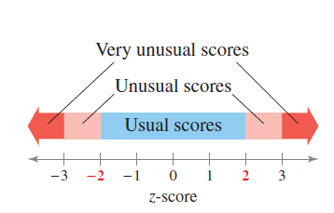
Z-Score Interpretation

Slide 10
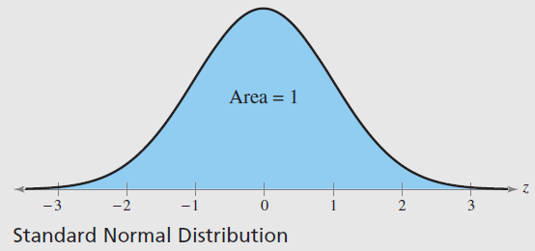
Normal Distribution and Probability
Standard normal distribution = Normal distribution with mean of 0 and standard deviation of 1
Total area under the curve = 1
Can be used to map Z-Score to probability of area under the curve (Next)

Slide 11
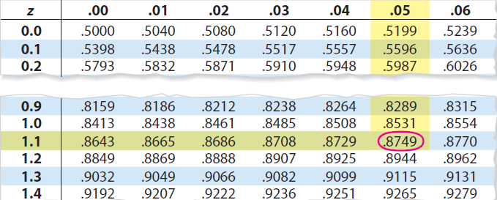
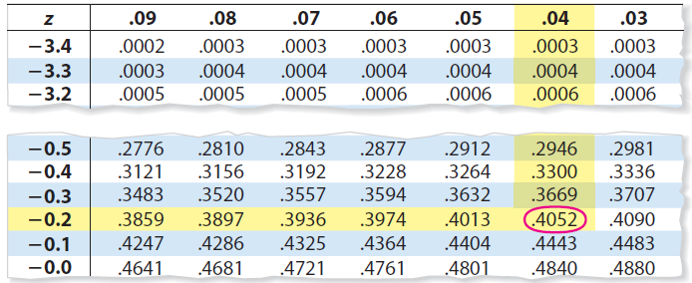
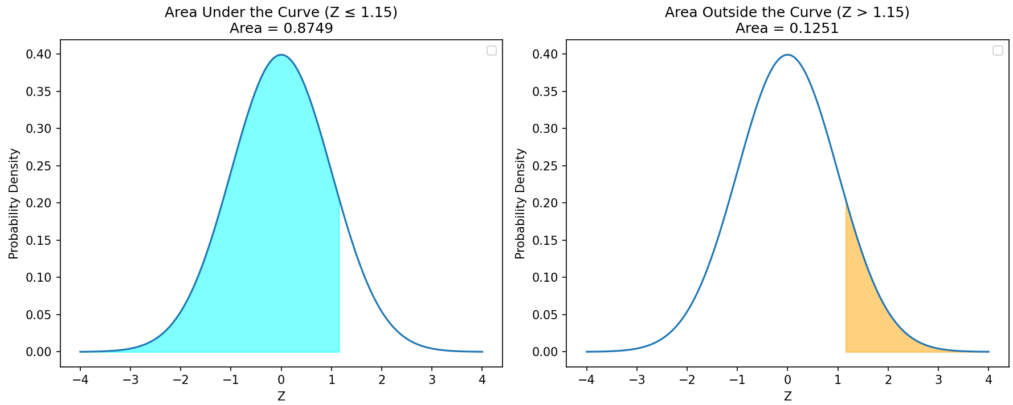
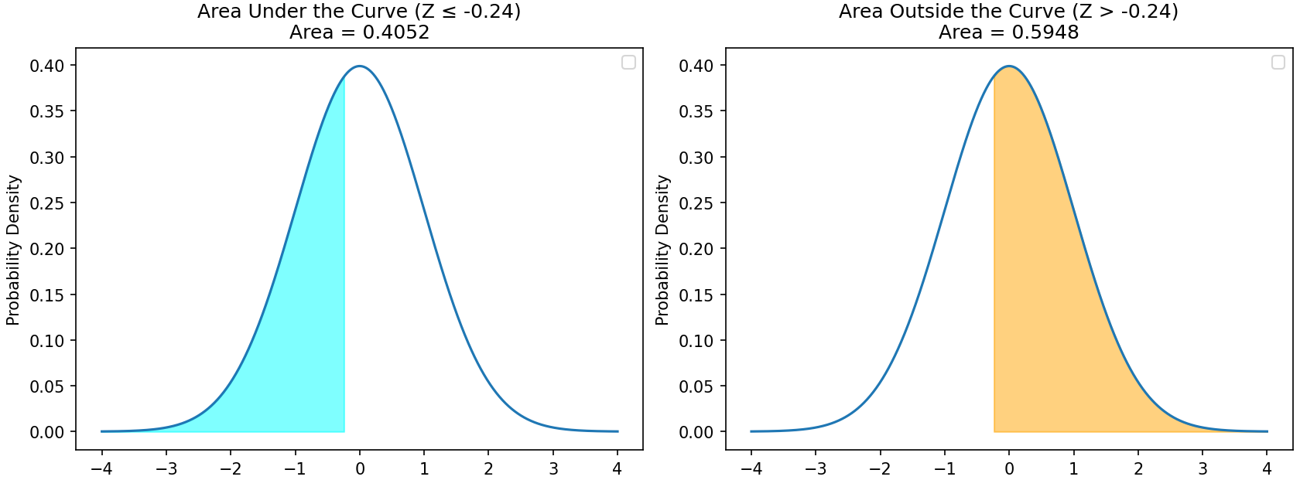
Understanding Z-Score and Area Under the Curve (Probability)
Suppose Z-Score = 1.15
Suppose Z-Score = -0.24

Slide 12
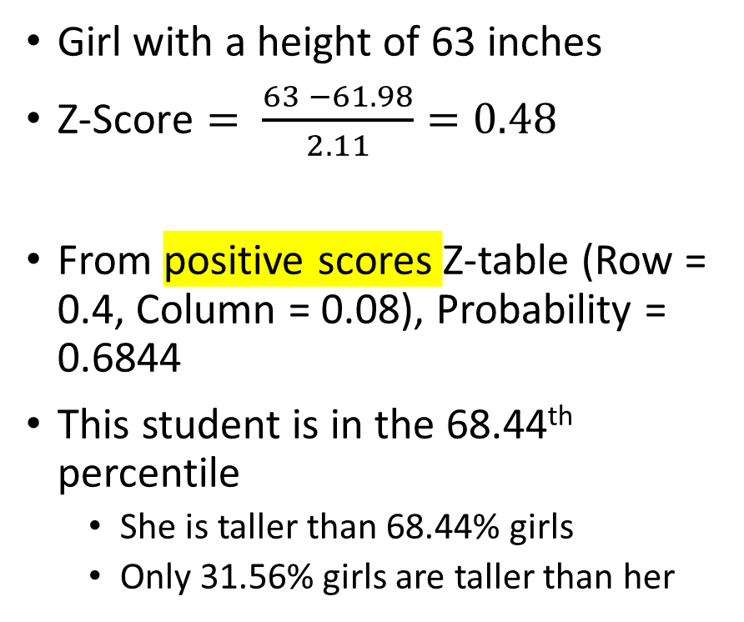
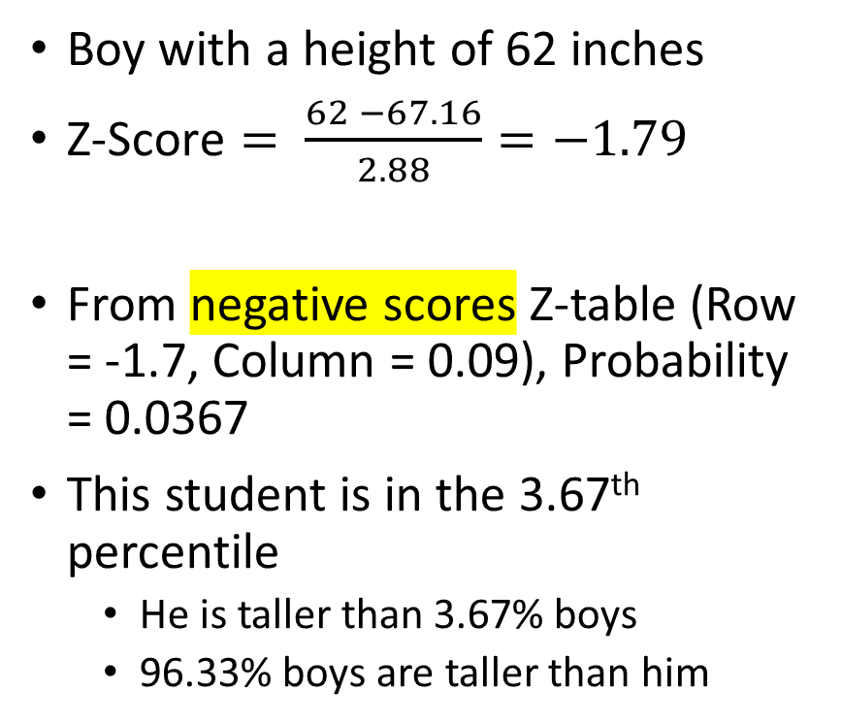
Student Example: Z-Scores, Probabilities, Percentiles
Boy with a height of 62 inches
$\text{Z}\text{−}\text{Score}= \frac{62 −67.16}{2.88}=−1.79$
From negative scores Z-table (Row = -1.7, Column = 0.09), Probability = 0.0367
This student is in the 3.67th percentile
He is taller than 3.67% boys
96.33% boys are taller than him
Girl with a height of 63 inches
$\text{Z}\text{−}\text{Score}= \frac{63 −61.98}{2.11}=0.48$
From positive scores Z-table (Row = 0.4, Column = 0.08), Probability = 0.6844
This student is in the 68.44th percentile
She is taller than 68.44% girls
Only 31.56% girls are taller than her

Slide 13
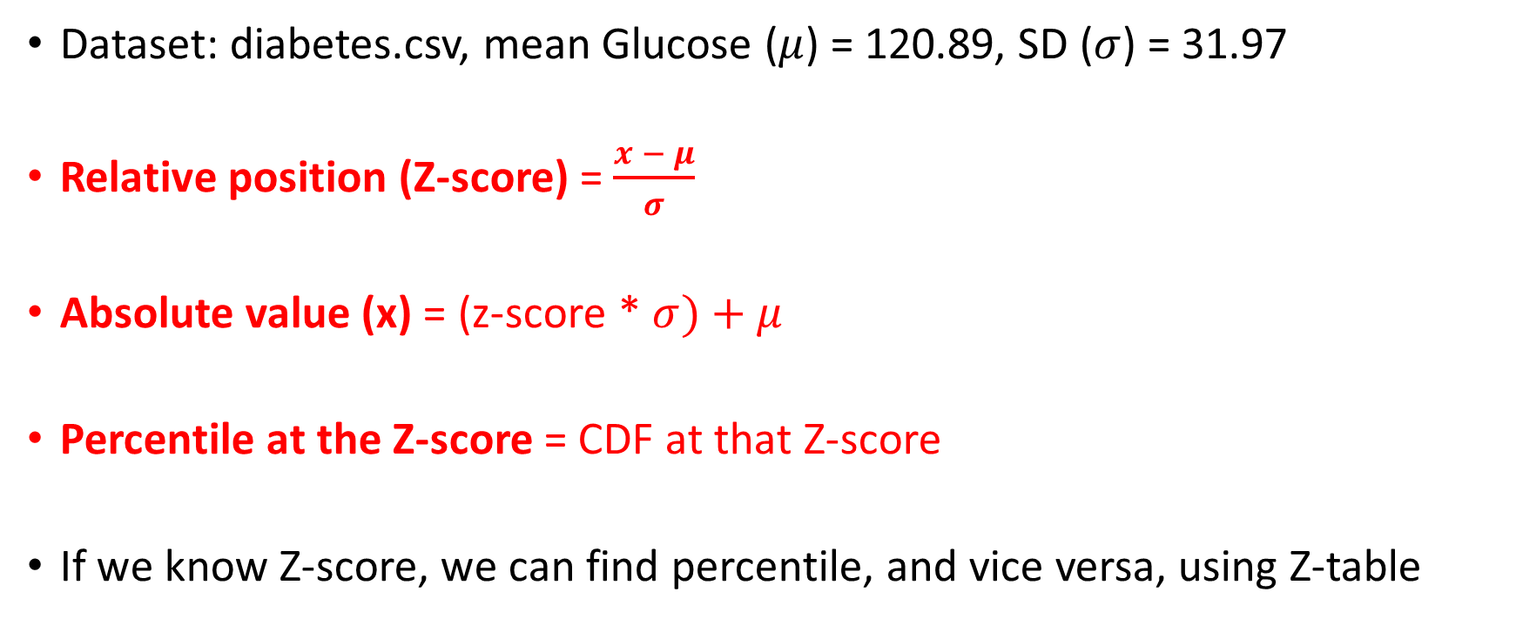
Three Important Measurements
Dataset: diabetes.csv, mean Glucose ($μ$) = 120.89, SD ($σ$) = 31.97
Relative position (Z-score) = $\frac{x − μ}{σ}$
Absolute value (x) = (z-score * $σ)+μ$
Percentile at the Z-score = CDF at that Z-score
If we know Z-score, we can find percentile, and vice versa, using Z-table

Slide 14
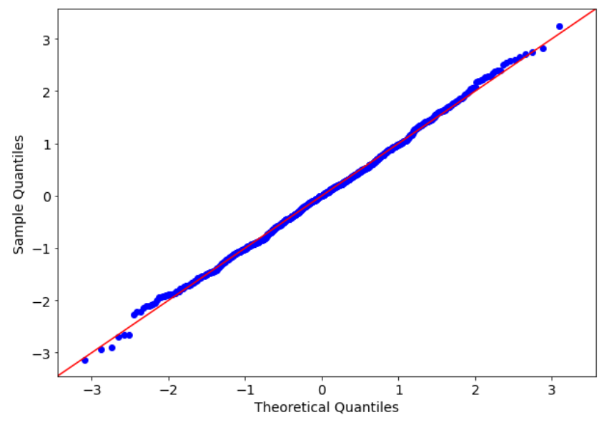
Is our Data Normally Distributed?
Shapiro-Wilk Test: p-value should be > 0.05 (Data size <= 5000 rows)
QQ plot (Quantile-Quantile): Ideal is straight line

Slide 15
The Central Limit Theorem (CLT)

Slide 16
Central Limit Theorem (CLT)
Problem: Suppose population data does not follow normal distribution (i.e. it is left/right-skewed)
Population->Samples
Example: 10 lakh examination result of students->500 samples of 100 students each
For each sample, calculate average marks (Sample mean or x̄)
Plot these sample means on a graph
They will follow normal distribution: Central Limit Theorem (CLT)
Generally, minimum sample size = 30
How many such samples? No such number
Result: Consider original population also as normally distributed now

Slide 17
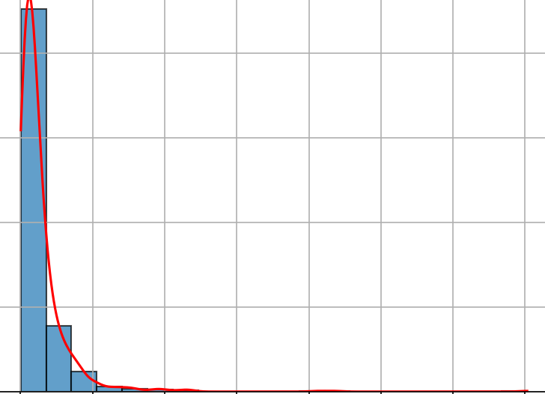
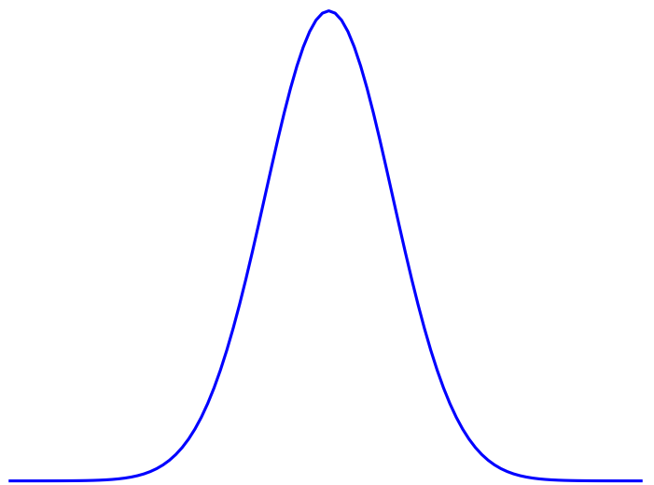
CLT
Population
Sample 1
Sample 2
Sample 3
..
Sample n
Sample mean
Sample mean
Sample mean
..
Sample mean

